Slide 1
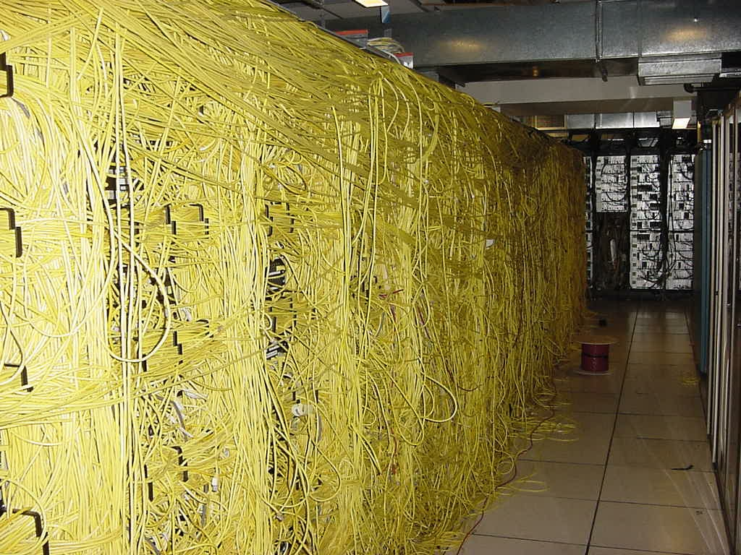
An Introduction to MapReduce:
Abstractions and Beyond!
-by-
Timothy Carlstrom
Joshua Dick
Gerard Dwan
Eric Griffel
Zachary Kleinfeld
Peter Lucia
Evan May
Lauren Olver
Dylan Streb
Ryan Svoboda

Slide 2
What We’ll Be Covering…
Background information/overview
Map abstraction
  Pseudocode example
Reduce abstraction
  Yet another pseudocode example
Combining the map and reduce abstractions
Why MapReduce is “better”
Examples and applications of MapReduce

Slide 3
Before MapReduce…
Large scale data processing was difficult!
  Managing hundreds or thousands of processors
  Managing parallelization and distribution
  I/O Scheduling
  Status and monitoring
  Fault/crash tolerance
MapReduce provides all of these, easily!
Source: http://labs.google.com/papers/mapreduce-osdi04-slides/index-auto-0002.html

Slide 4
MapReduce Overview
What is it?
  Programming model used by Google
  A combination of the Map and Reduce models with an associated implementation
  Used for processing and generating large data sets

Slide 5
MapReduce Overview
How does it solve our previously mentioned problems?
  MapReduce is highly scalable and can be used across many computers.
  Many small machines can be used to process jobs that normally could not be processed by a large machine.

Slide 6
Map Abstraction
Inputs a key/value pair
  Key is a reference to the input value
  Value is the data set on which to operate
Evaluation
  Function defined by user
  Applies to every value in value input
    Might need to parse input
Produces a new list of key/value pairs
  Can be different type from input pair

Slide 7
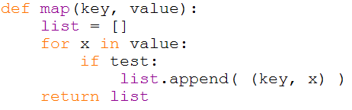
Map Example

Slide 8
Reduce Abstraction
Starts with intermediate Key / Value pairs
Ends with finalized Key / Value pairs
Starting pairs are sorted by key
Iterator supplies the values for a given key to the Reduce function.

Slide 9
Reduce Abstraction
Typically a function that:
  Starts with a large number of key/value pairs
    One key/value for each word in all files being greped (including multiple entries for the same word)
  Ends with very few key/value pairs
    One key/value for each unique word across all the files with the number of instances summed into this entry
Broken up so a given worker works with input of the same key.

Slide 10
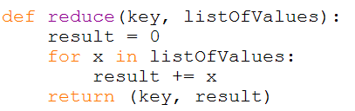
Reduce Example

Slide 11
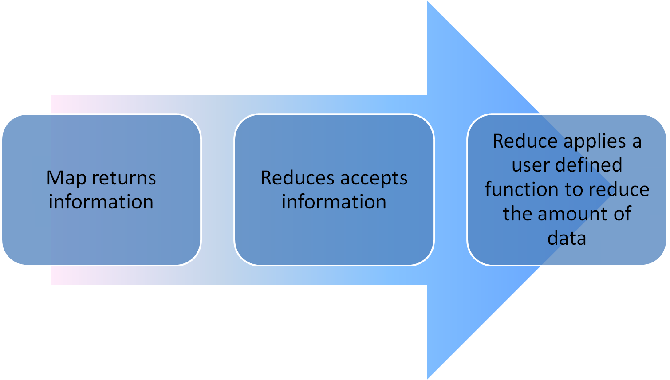
How Map and Reduce Work Together

Slide 12
How Map and Reduce Work Together
Map returns information
Reduces accepts information
Reduce applies a user defined function to reduce the amount of data

Slide 13
Other Applications
Yahoo!
  Webmap application uses Hadoop to create a database of information on all known webpages
Facebook
  Hive data center uses Hadoop to provide business statistics to application developers and advertisers
Rackspace
  Analyzes sever log files and usage data using Hadoop

Slide 14
Why is this approach better?
Creates an abstraction for dealing with complex overhead
  The computations are simple, the overhead is messy
Removing the overhead makes programs much smaller and thus easier to use
  Less testing is required as well. The MapReduce libraries can be assumed to work properly, so only user code needs to be tested
Division of labor also handled by the MapReduce libraries, so programmers only need to focus on the actual computation

Slide 15
MapReduce Example 1/4
package org.myorg;
import java.io.IOException;
import java.util.*;
import org.apache.hadoop.fs.Path;
import org.apache.hadoop.conf.*;
import org.apache.hadoop.io.*;
import org.apache.hadoop.mapred.*;
import org.apache.hadoop.util.*;
public class WordCount {
public static class Map extends MapReduceBase implements Mapper<LongWritable, Text, Text, IntWritable> {
private final static IntWritable one = new IntWritable(1);
private Text word = new Text();

Slide 16
MapReduce Example 2/4
public void map(LongWritable key, Text value, OutputCollector<Text, IntWritable> output, Reporter reporter) throws IOException {
String line = value.toString();
StringTokenizer tokenizer = new StringTokenizer(line);
while (tokenizer.hasMoreTokens()) {
word.set(tokenizer.nextToken());
output.collect(word, one);
}
}
}

Slide 17
MapReduce Example 3/4
public static class Reduce extends MapReduceBase implements Reducer<Text, IntWritable, Text, IntWritable> {
public void reduce(Text key, Iterator<IntWritable> values, OutputCollector<Text, IntWritable> output, Reporter reporter) throws IOException {
int sum = 0;
while (values.hasNext()) {
sum += values.next().get();
}
output.collect(key, new IntWritable(sum));
}
}

Slide 18
MapReduce Example 4/4
public static void main(String[] args) throws Exception {
JobConf conf = new JobConf(WordCount.class);
conf.setJobName("wordcount");
conf.setOutputKeyClass(Text.class);
conf.setOutputValueClass(IntWritable.class);
conf.setMapperClass(Map.class);
conf.setCombinerClass(Reduce.class);
conf.setReducerClass(Reduce.class);
conf.setInputFormat(TextInputFormat.class);
conf.setOutputFormat(TextOutputFormat.class);
conf.setInputPath(new Path(args[0]));
conf.setOutputPath(new Path(args[1]));
JobClient.runJob(conf);
}

Slide 19
Summary
Map reads in text and creates a {<word>, 1} pair for every word read
Reduce then takes all of those pairs and counts them up to produce the final count.
  If there were 20 {word, 1} pairs, the final output of Reduce would be a single {word, 20} pair

